Slide 1
AUTOMATED ESSAY GRADING
TEAM MEMBERS:
SIDDANTH CHANDRA UDUTHA-19R11A04D9
T.SAHAJA REDDY-19R11A04E1
V.JAYASREE-19R11A04E2
Y.SANDHYA-19R11A04E4
B.R.MADHAVI-19R11A04E5

Slide 2
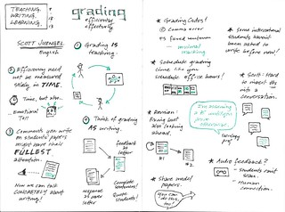
CONTENTS
INTRODUCTION
LITERATURE SURVEY
THEORITICAL ANALYSIS
EXPERIMENTAL INVESTIGATIONS
FLOWCHART
RESULT
CONCLUSION

Slide 3
INTRODUCTION:
Essays are considered by many researchers as the most useful tool to assess learning outcomes, implying the ability to recall, organize and integrate ideas, the ability to express oneself in writing and the ability to supply merely than identify interpretation and application of data. It is in the measurement of such outcomes, corresponding to the evaluation and synthesis levels of the Bloom’s (1956) taxonomy that the essay questions serve their most useful purpose.
One of the difficulties of grading essays is represented by the perceived subjectivity of the grading process. Many researchers claim that the subjective nature of essay assessment leads to variation in grades awarded by different human assessors, which is perceived by students as a great source of unfairness. This issue may be faced through the adoption of automated assessment tools for essays

Slide 4
LITERATURE SURVEY:
PROBLEM STATEMENT:
generally in grading essays, Manual scoring has a large workload and sometimes is subjective according to different experts and also consume more time.
PROPOSED SOLUTION:
The goal of automated essay grading(AEG) is to enable computers to score students’ essays automatically, thereby reducing the subjectivity of manual ratings and the workload of teachers and speeding up the feedback in the learning process.
we have used LSTM machine learning technique to build the model automated essay grading.

Slide 5
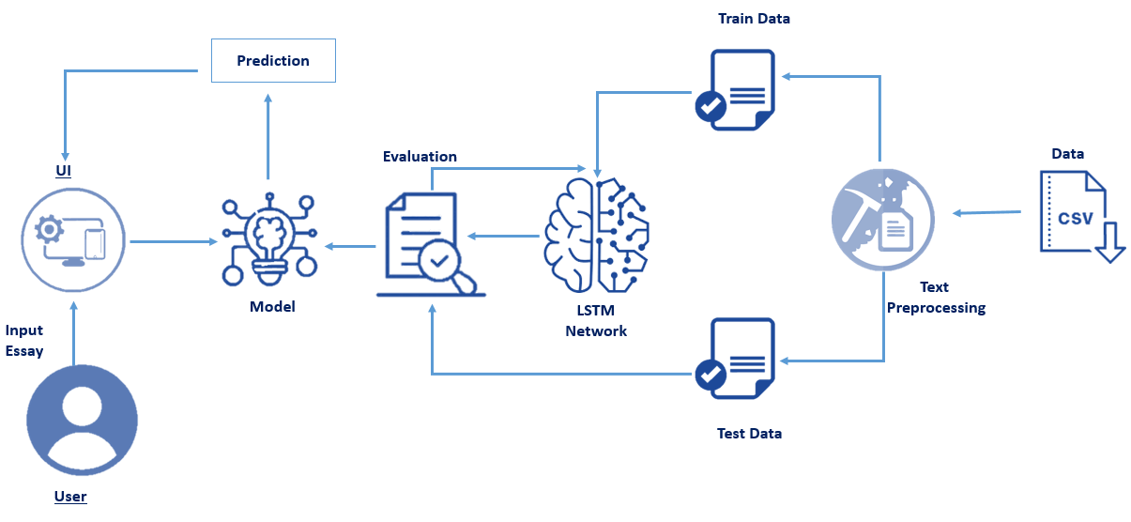
THEORITICAL ANALYSIS:
BLOCK DIAGRAM:

Slide 6
HARDWARE AND SOFTWARE DESIGNING:
In order to develop this project we need to install the following software/packages:
Anaconda Navigator :
Anaconda Navigator is a free and open-source distribution of the Python and R programming languages for data science and machine learning related applications. It can be installed on Windows, Linux, and macOS.Conda is an open-source, cross-platform, package management system. Anaconda comes with so very nice tools like JupyterLab, Jupyter Notebook,
QtConsole, Spyder, Glueviz, Orange, Rstudio, Visual Studio Code. For this project, we will be using Jupyter notebook and Spyder

Slide 7
To build Deep learning models you must require the following packages
Tensor flow: TensorFlow is an end-to-end open-source platform for machine learning. It has a comprehensive, flexible ecosystem of tools, libraries, and community resources that lets researchers push the state-of-the-art in ML and developers can easily build and deploy ML-powered applications.
Keras: Keras leverages various optimization techniques to make high-level neural network API easier and more performant. It supports the following features:
Consistent, simple, and extensible API.
Minimal structure - easy to achieve the result without any frills.
It supports multiple platforms and backends.
It is a user-friendly framework that runs on both CPU and GPU.
Highly scalability of computation.
Flask: Web framework used for building Web applications

Slide 8
EXPERIMENTAL INVESTIGATIONS:
While working on the solution we have investigated the following topics
Supervised and unsupervised learning
Regression Classification and Clustering
Artificial Neural Networks
Natural Language Processing
Flask app
LSTM and GRU

Slide 9
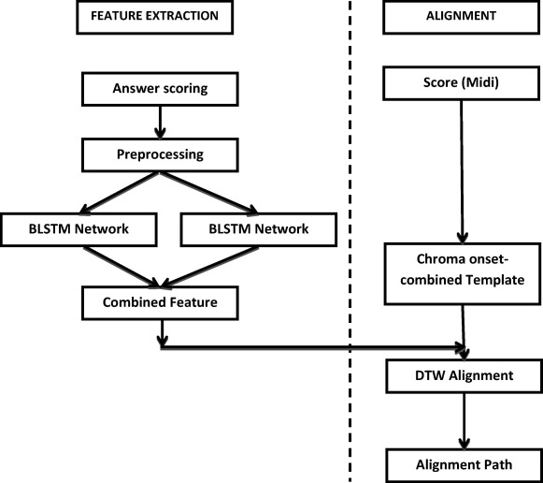
FLOW CHART:

Slide 10
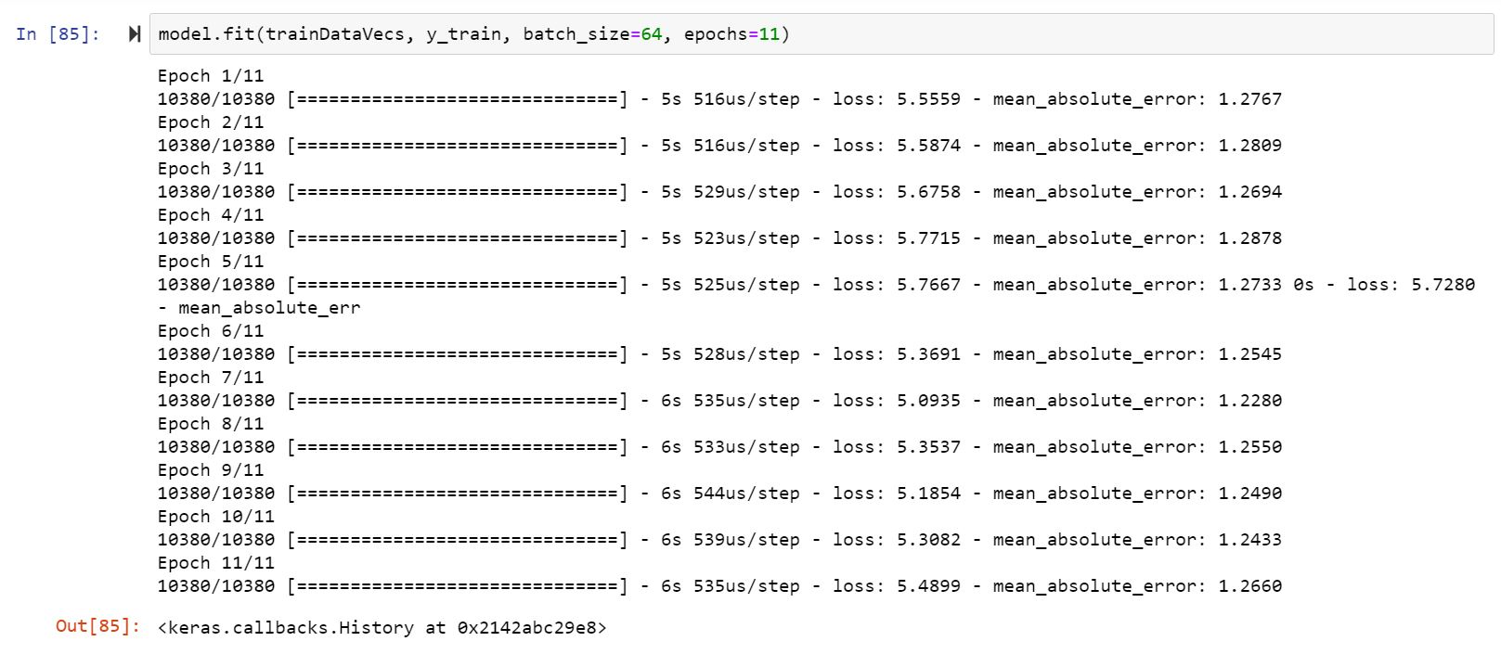
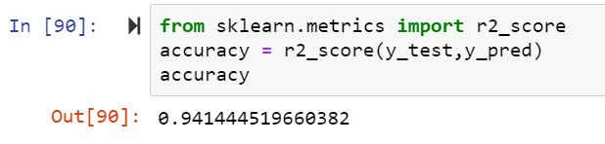
RESULT:
Result after model building:

Slide 11

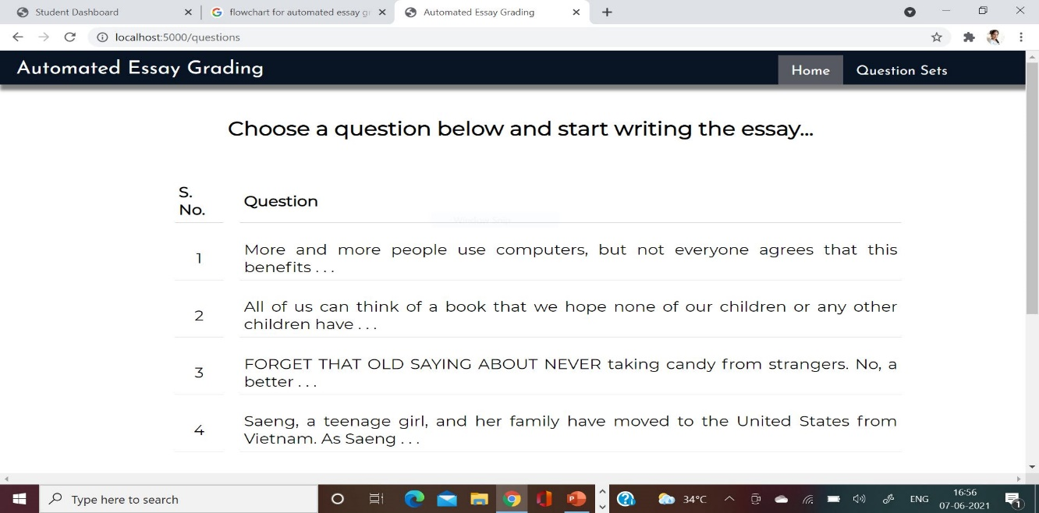
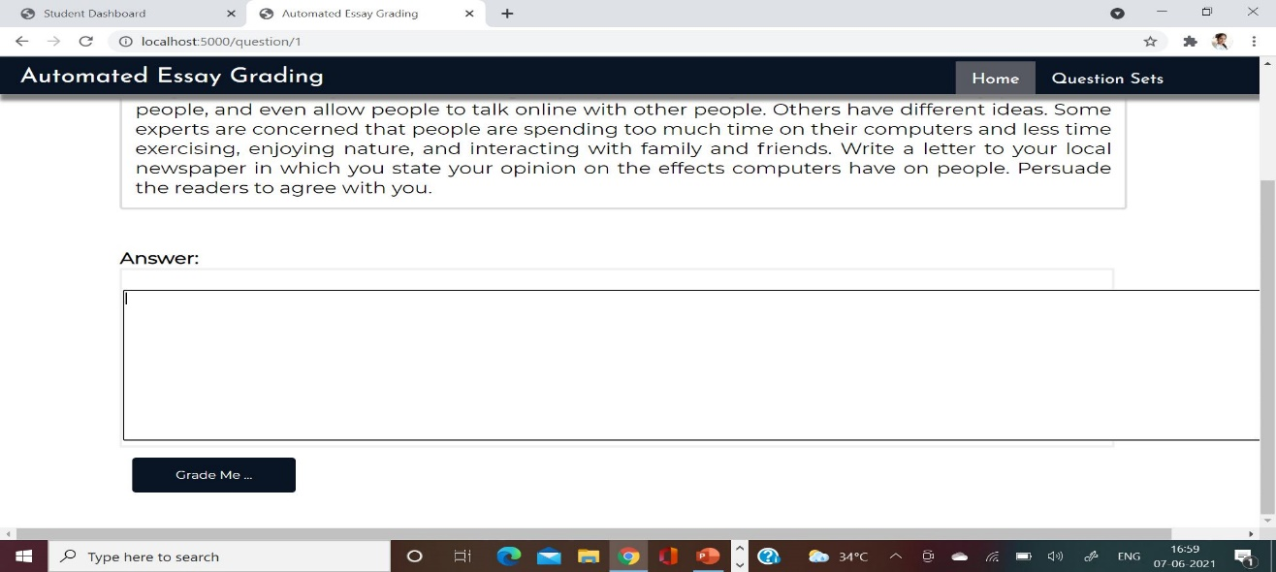
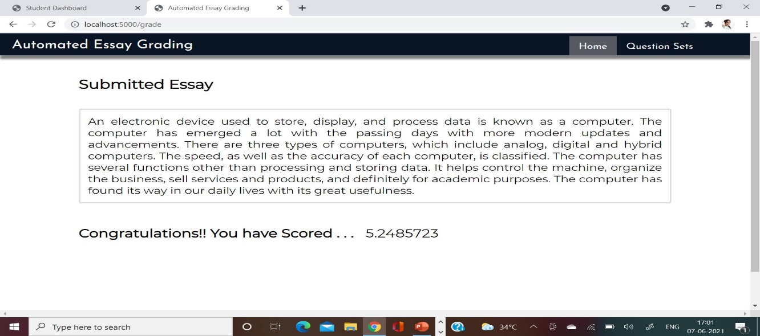
Result after web application:

Slide 12
CONCLUSION:
We have built an machine learning model to read and grade the essay using LSTM technique.
We have developed an web application using the built model by python flask application.
The built application is intregrated with 4 html pages
1.home
2.questions
3.submission
4.grade.

Slide 13
THANK YOU……

